Slide 1
Monitoring and sharing information about HPAI in the Canadian Arctic: lessons learned in the past two years
David Hik, Chief Scientist/Executive Director (Programs)
23 August 2023

Slide 2
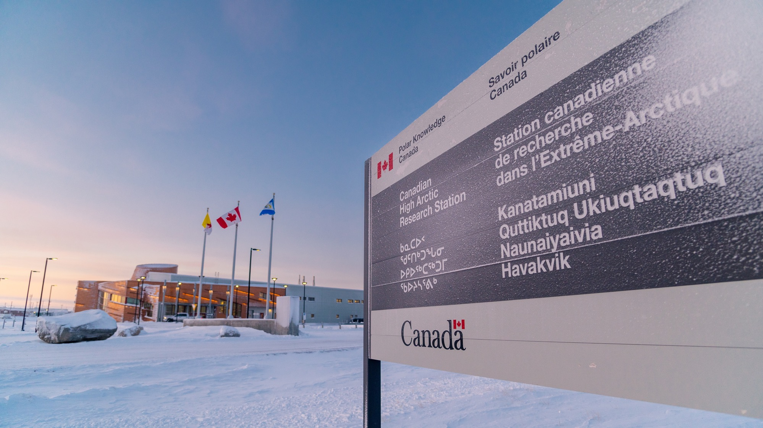

Slide 3
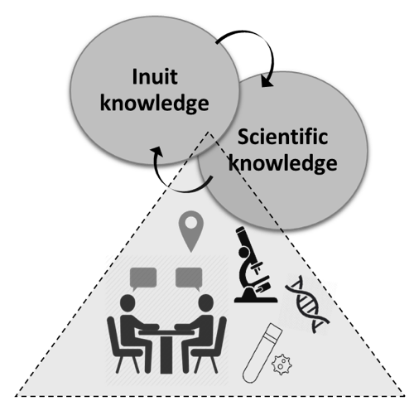
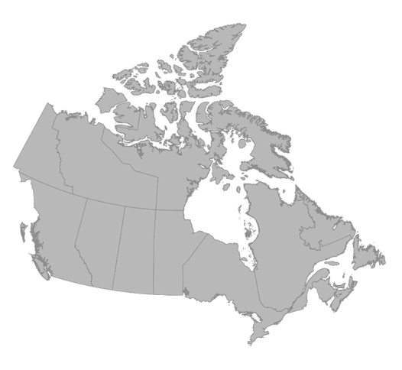
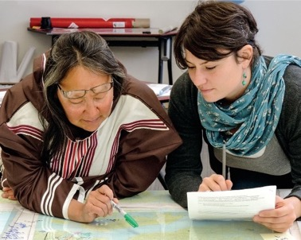
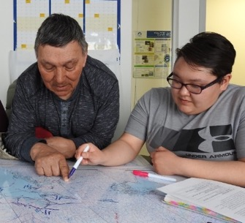
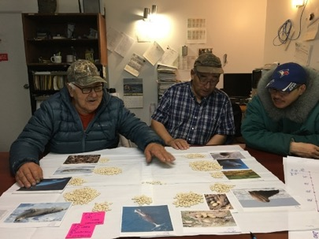
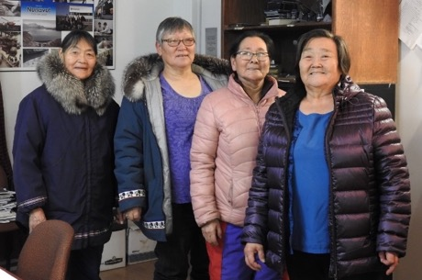
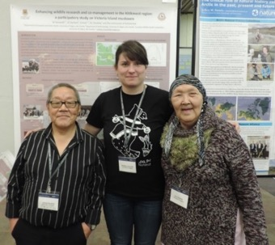
Improving Wildlife Health Monitoring and Surveillance
Participatory epidemiology research on wildlife health
Narwhal
Inuit Qaujimajatuqangit is documented and used alongside Western Science to improve our understanding of health status of wildlife populations.
Muskox
Caribou
Predators
Bottom-up process
Polar bear
POLAR leads: Dr. Mathilde Tomeselli
Dr. Andrew Bresnahan
Participatory Wildlife Health Surveillance

Slide 4
https://www.canada.ca/en/polar-knowledge/publications/avian-influenza-in-canada.html
This webpage contains links to all
of the information I will discuss
(and more)
And make sure to watch the
information video!

Slide 5
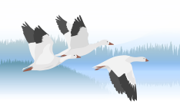
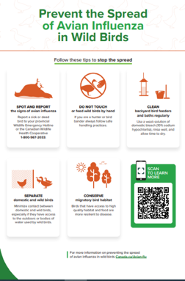
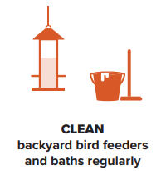
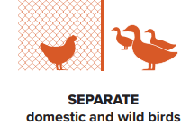
Working framework for a coordinated response: example of intra- and inter-agency collaboration and teamwork
HPAI
PHAC
ISC
Planned engagement with KRWB
Spring 2022
Communication
& distribution plan
CFIA
ECCC (CWS)
Knowledge Mobilization Team
S&T Team
Environment, Health & Comms Depts
Communications Team
This Photo by Unknown Author is licensed under CC BY

Slide 6
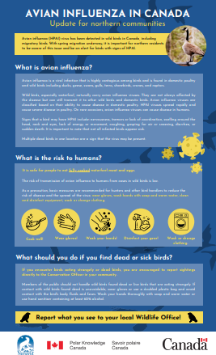
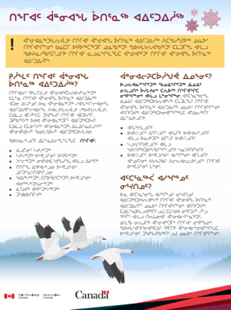
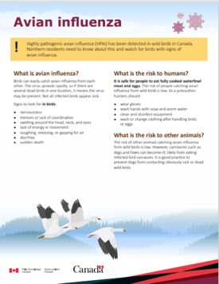
POLAR led on efforts to provide information across northern Canada
Content development
with northern relevance
HPAI factsheet
POLAR Web content
Print-friendly PDFs EN FR IK IN Media campaign
POLAR mandate area
across Canada (ECCC reports)
Updated as needed
This Photo by Unknown Author is licensed under CC BY

Slide 7
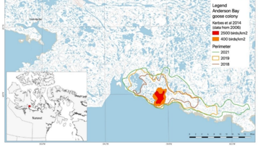
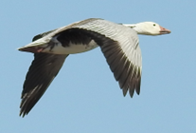
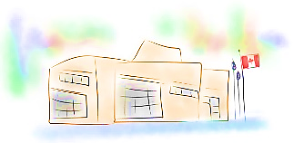
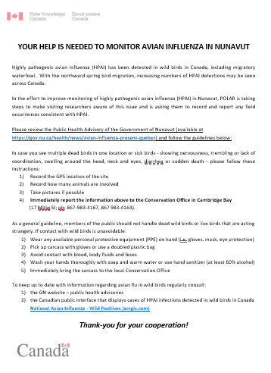
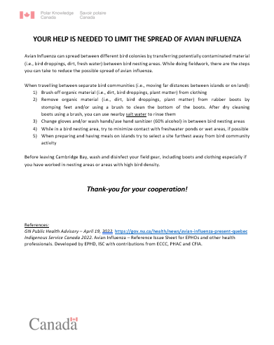
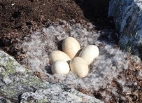
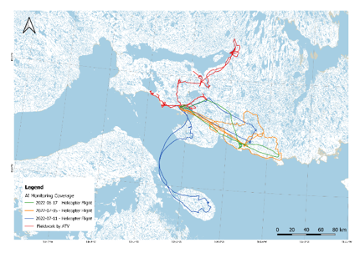
Developing operating protocols and monitoring strategy
Facilities and Research
Support at CHARS
Anderson Bay goose colony
General field
operations
Protocols for visiting researchers
Summer field season 2022 and 2023
Protocols for field operations

Slide 8
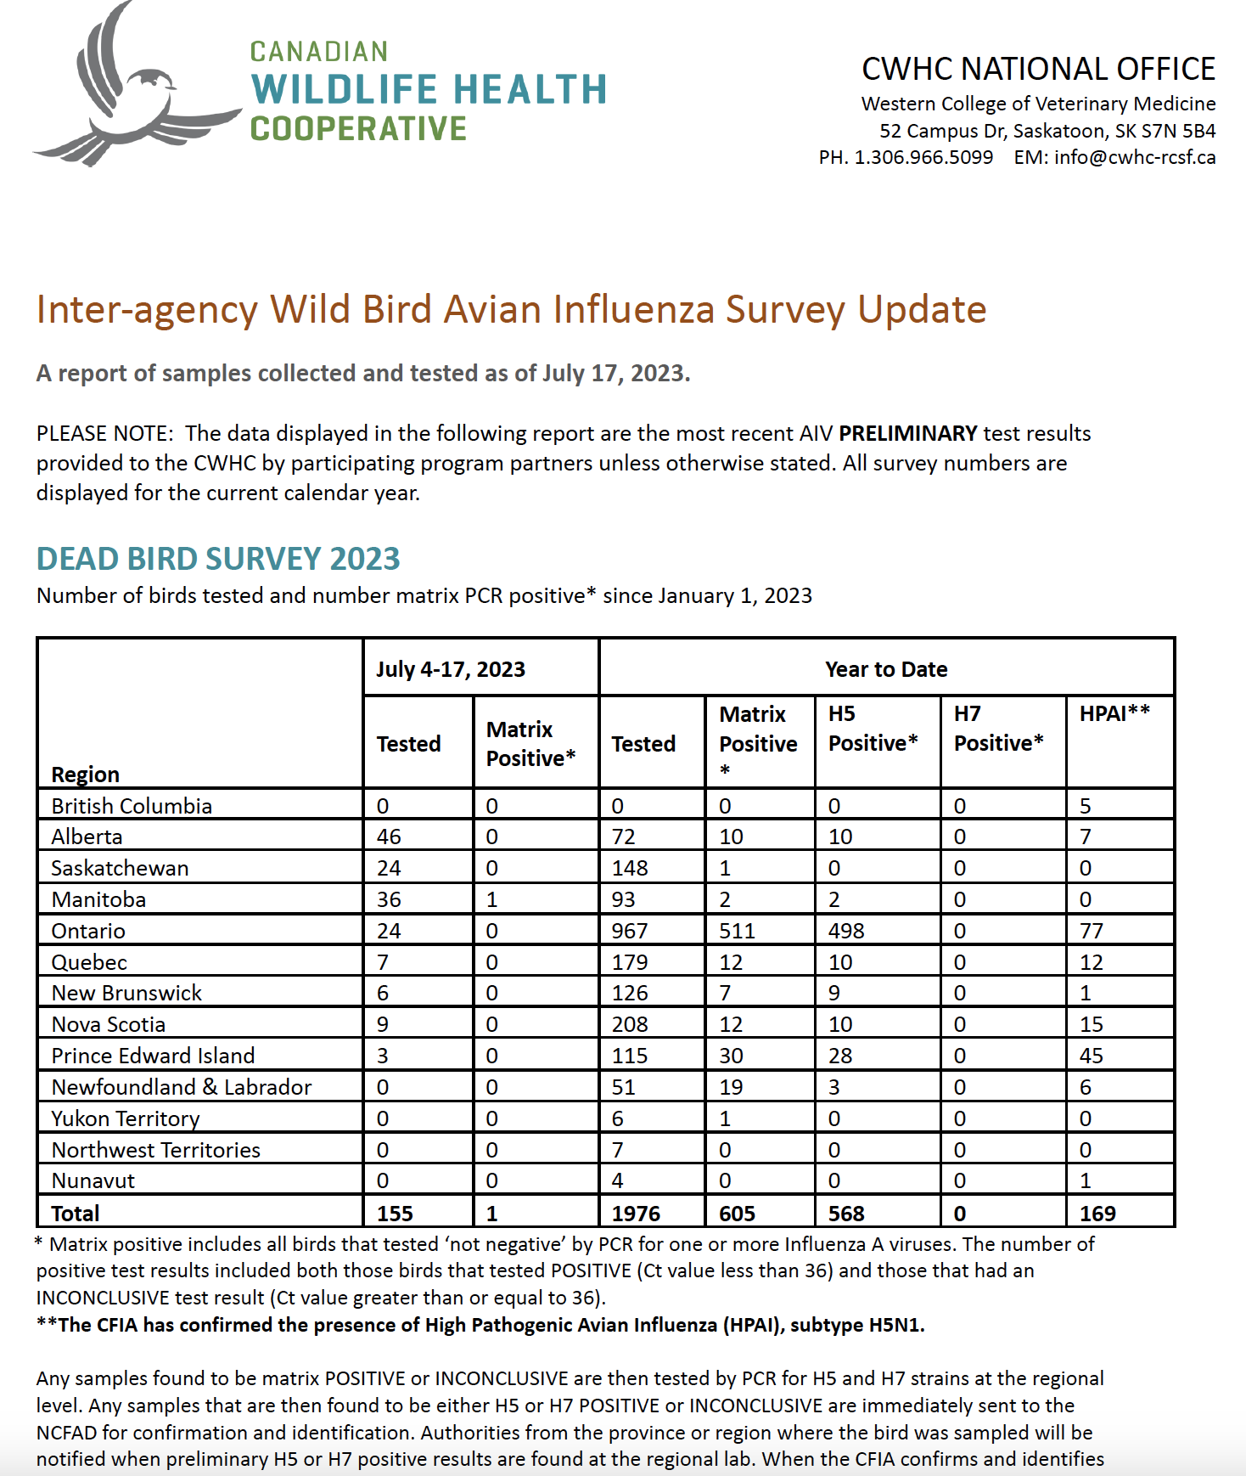
http://www.cwhc-rcsf.ca/avian_influenza_biweekly_reports.php
Biosurveillance results are posted every second week

Slide 9
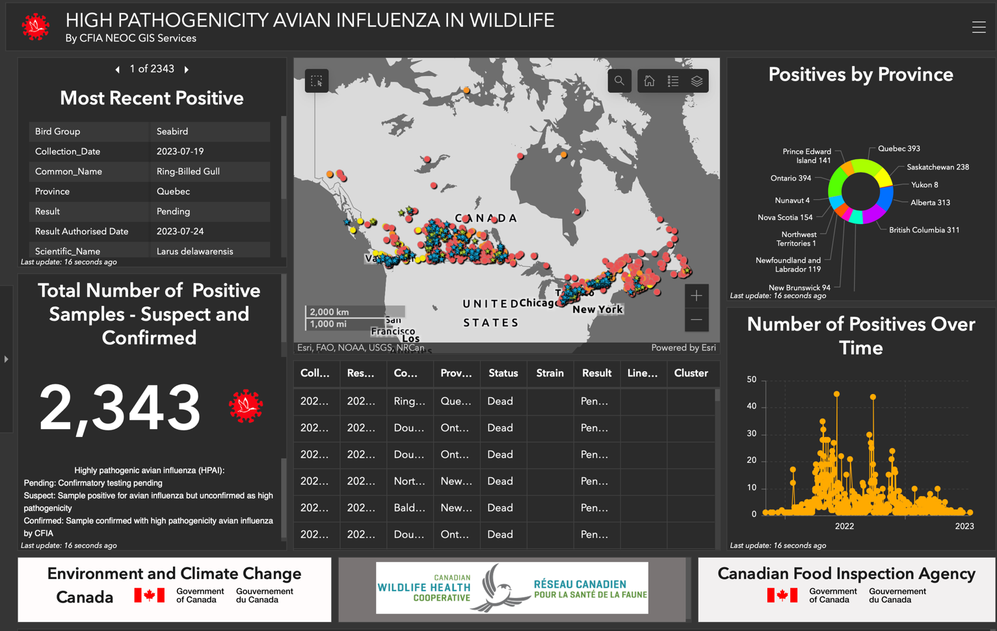
https://cfia-ncr.maps.arcgis.com/apps/dashboards/89c779e98cdf492c899df23e1c38fdbc
Positive results
are mapped and
searchable as new
Information becomes
available

Slide 10
Please contact POLAR for more information: Andrew Bresnahan: andrew.bresnahan@polar-polaire.gc.ca David Hik: david.hik@polar-polaire.gc.ca
Email
Info@polaire.gc.ca
Instagram
polar.knowledge (EN)
savoir.polaire (FR)
Twitter
@POLARCanada (EN)
@POLAIRECanada (FR)
Facebook
Polar Knowledge Canada (EN)
Savoir polaire Canada (FR)
Website
http://www.canada.ca/en/polar-knowledge (English)
http://www.canada.ca/fr/savoir-polaire (French)

